Slide 1
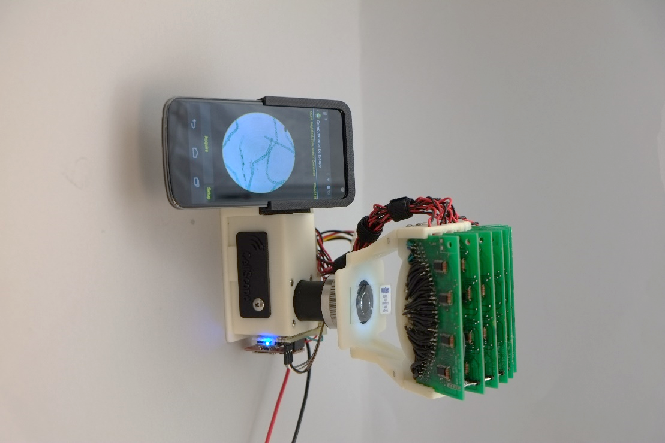
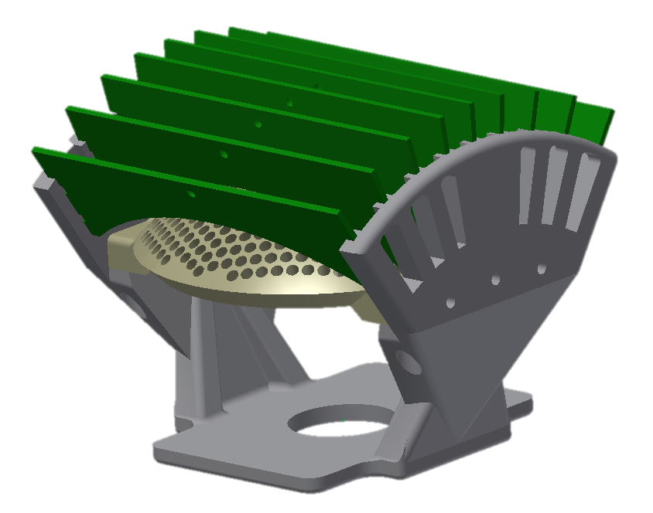
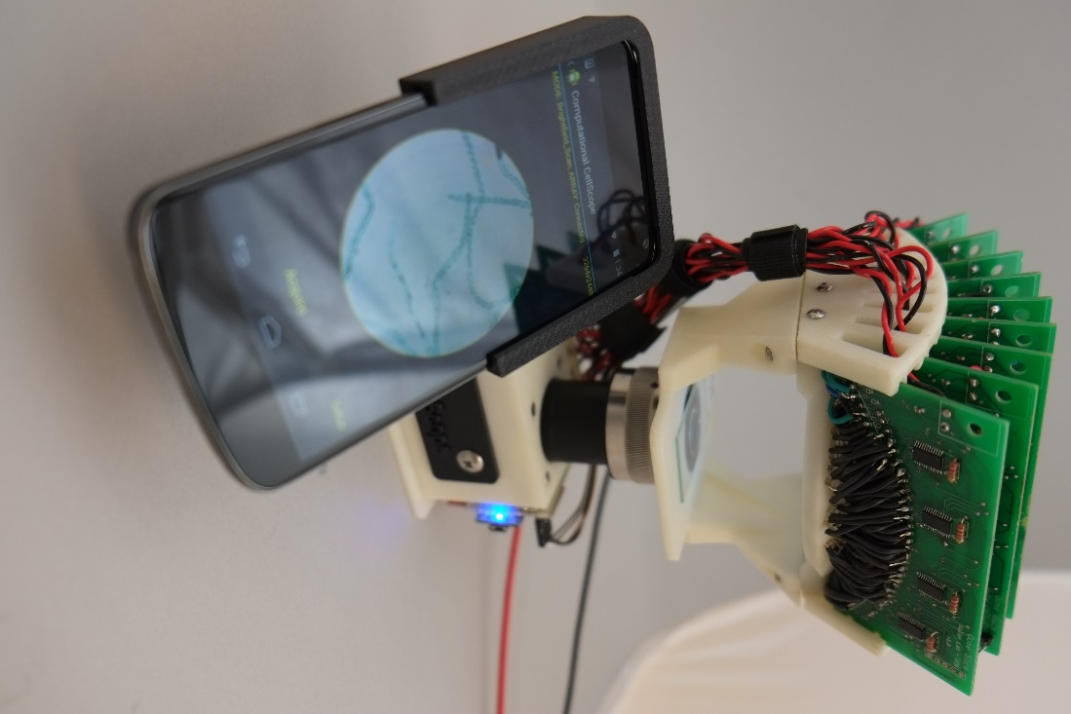
a)
b)
Smartphone
Sample
Eyepiece
Objective
Existing CellScope Hardware
c)
d)
Figure 1 – Computational CellScope
Device observing a sample using a Nexus 4 smartphone. Phone mounts are interchangeable and can be modified to accommodate a variety of smartphones
Optical schematic of the device. Here we replace the single LED illumination of the CellScope with a domed LED illuminator
CAD assembly of the device
Assembled device. Nine printed circuit boards control 508 individually addressable LEDs

Slide 2
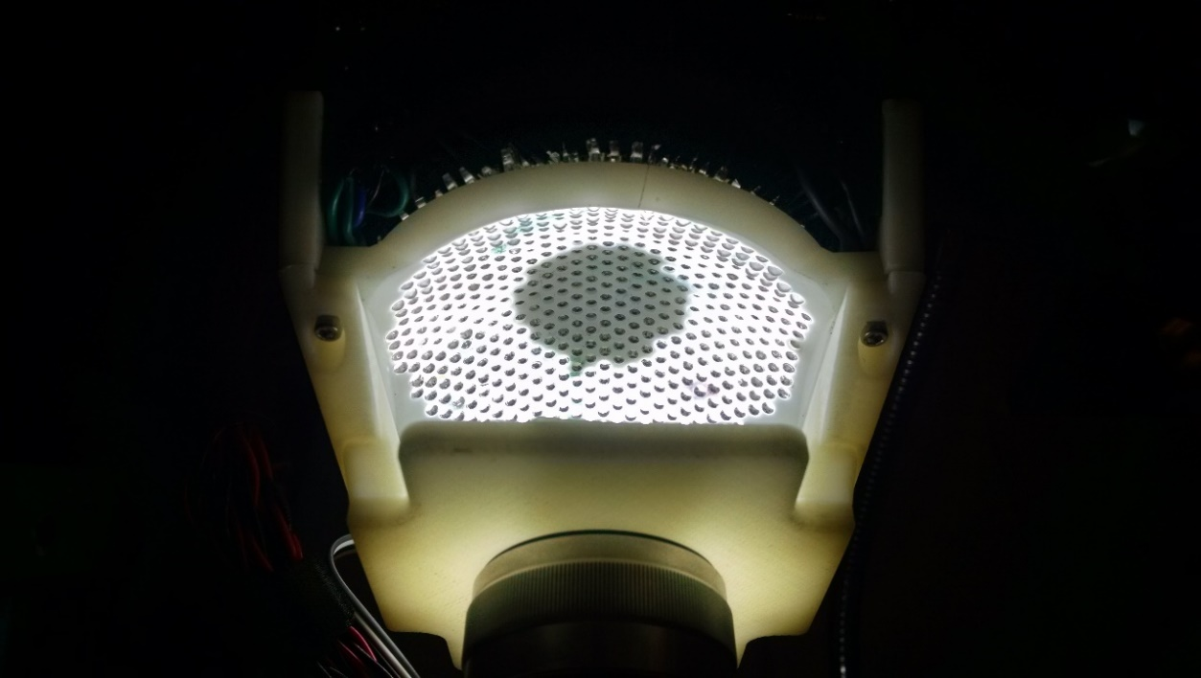
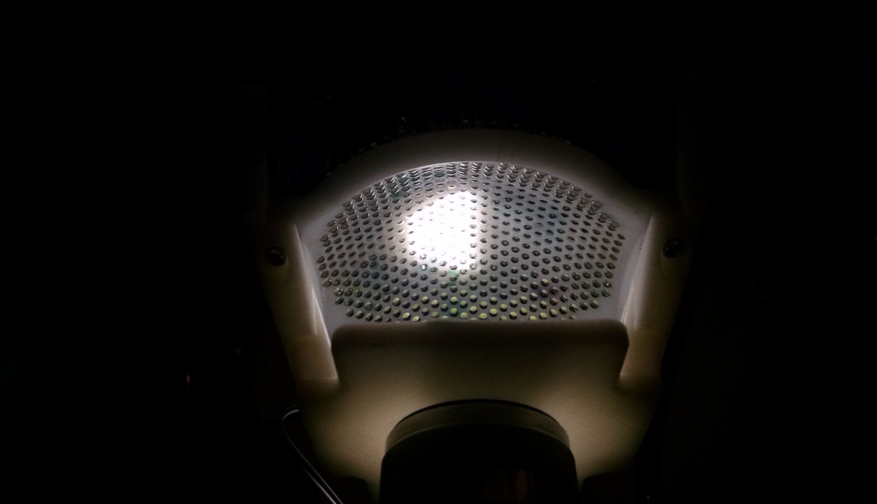
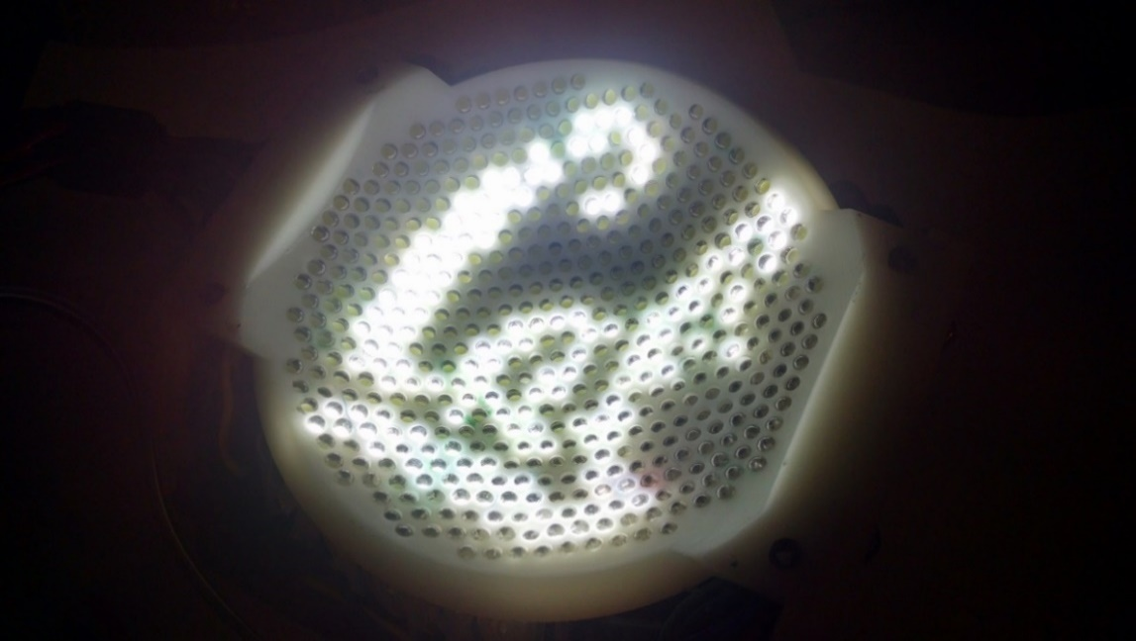
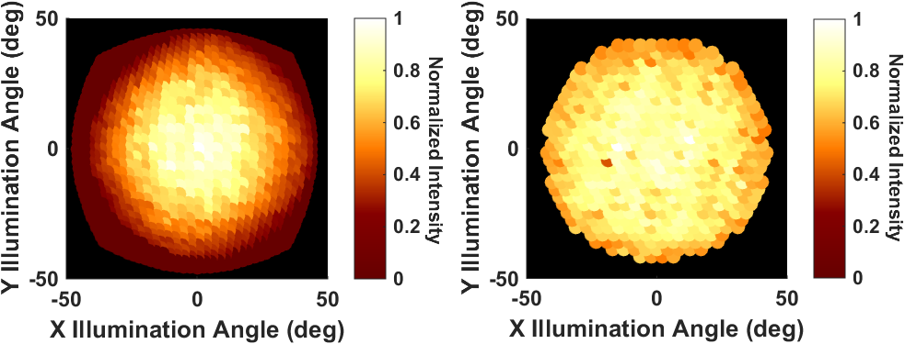
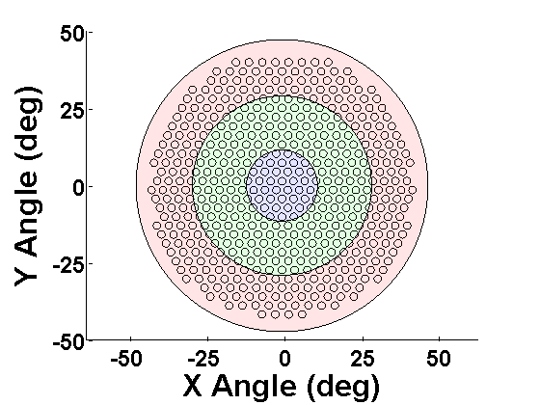
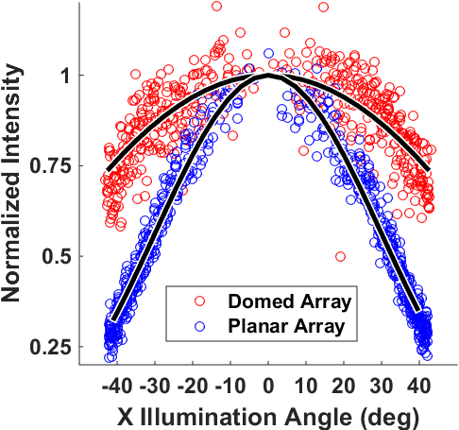


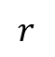
a)
b)
c)
d)
Planar Array
Domed Array
e)
f)
g)
40X
20X
$$r$$
$$r/\cos\left(θ\right)$$
$$r$$
10X
Sample
LEDs
Figure 2 – Domed LED Illuminator
Visual comparison of a planar array to a domed LED array. The intensity of a spherical wave degrades as a function of the inverse square of radius, thus illumination at the sample is heavily dependent on the distance between the LEDs and the sample. In the planar case (left), LED distance $r$ increases as a function of illumination angle, causing weaker illumination at higher angles. A domed LED array (right) eliminates this variation ($r$ is constant).
Normalized mean pixel intensities as measured by the CCD for the planar and domed array. Intensity decreases as a function of angles in both cases due to vignetting at the objective at higher angles; however, the dome illumination is significantly stronger at high angles. Values were normalized to the maximum mean brightness in both cases.
C. Illumination pattern for a 0.25NA objective, used to acquire dark field image
D. Illumination pattern for a 0.25NA objective, used to synthesize differential phase contrast images
E. Illustration of arbitrary illumination patterning capabilities of the device
F. Plot illustrating relative objective and illumination NA for several common objective magnifications
G. Normalized measured intensity falloff as a function of angle relative to the optical axis for the domed and planar LED arrays. We note that while illumination intensity decreases with incident angle in both cases, our domed array provides significant improvement in illumination at the sample compared to a planar array. Data were fit to a $\cos{\theta} curve and $\cos^4{\theta} curve for the domed and planar arrays, respectively.

Slide 3
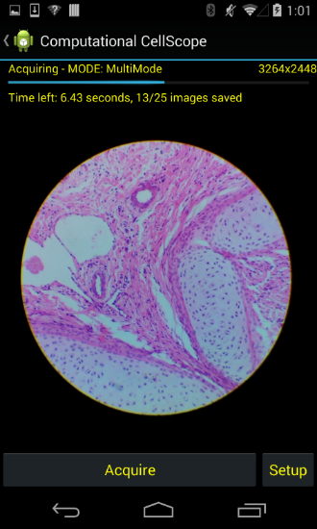
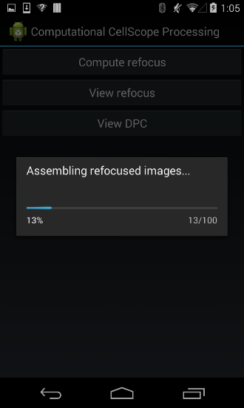
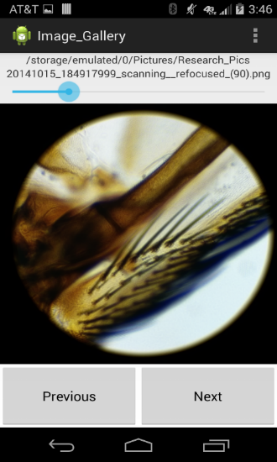
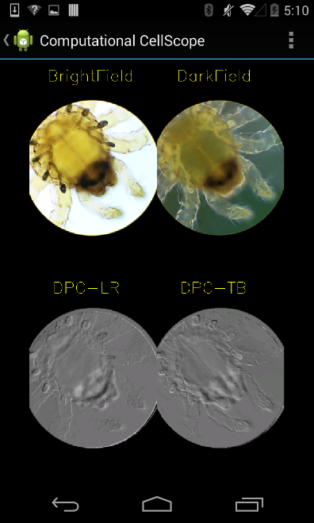
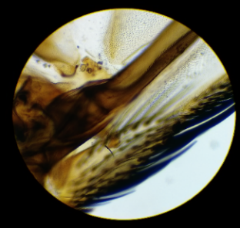
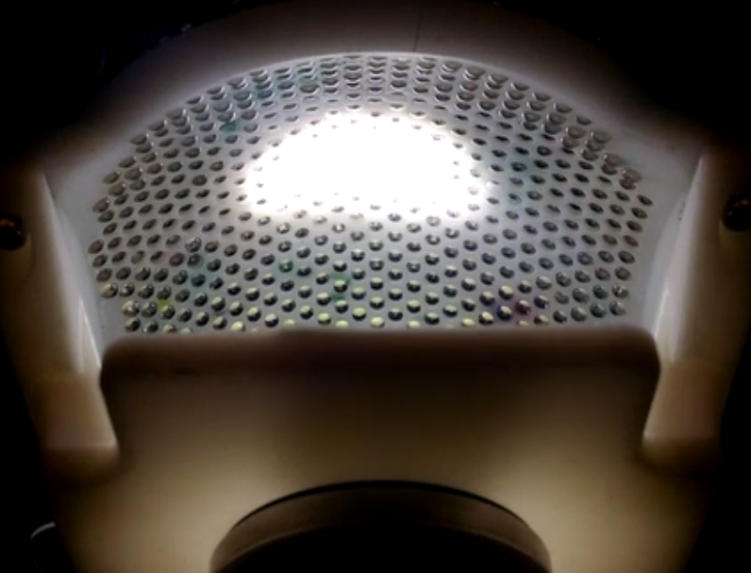
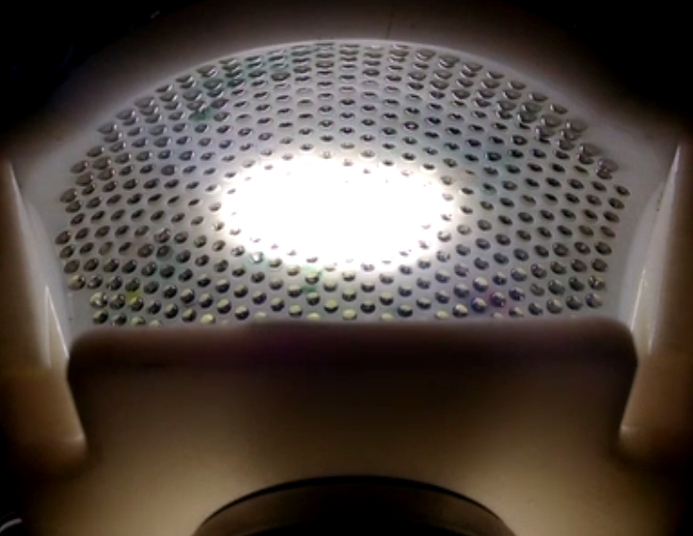
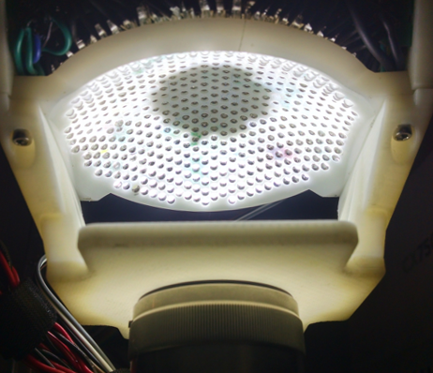
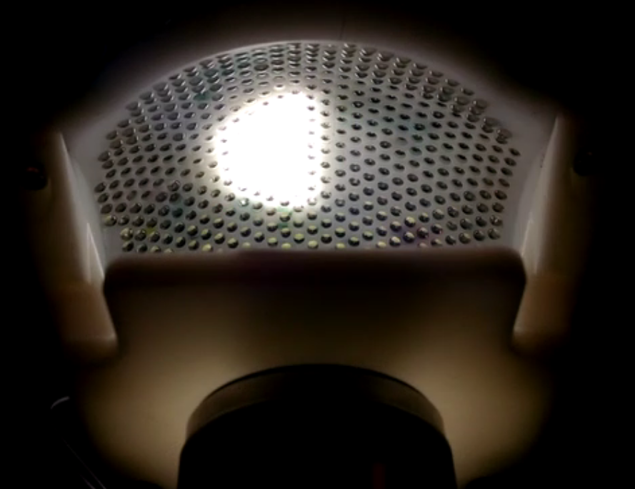
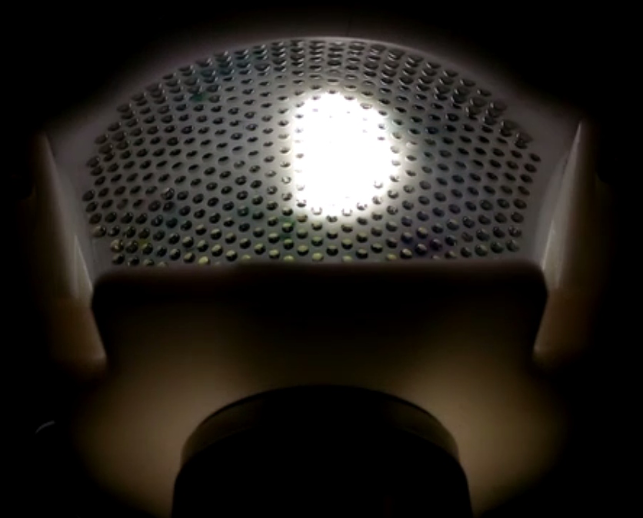
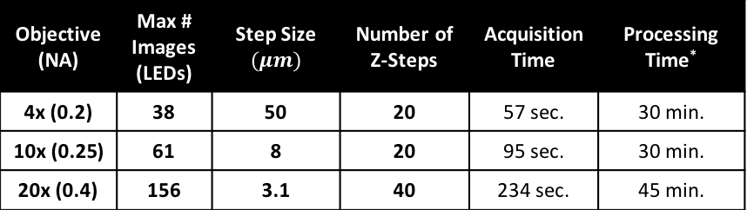
a)
Digital Refocusing
Streaming Multi-Contrast
Acquire
Process
View
b)
Streaming View
Illumination Pattern
Top
Bottom
Brightfield
Darkfield
DPC Left/Right
DPC Top/Bottom
Objective(NA) | Max # Images (LEDs) | Step Size $$(μm)$$ | Number of Z-Steps | Acquisition Time | Processing Time*
4x (0.2) | 38 | 50 | 20 | 57 sec. | 30 min.
10x (0.25) | 61 | 8 | 20 | 95 sec. | 30 min.
20x (0.4) | 156 | 3.1 | 40 | 234 sec. | 45 min.
Dark Field
Left
Right
Figure 3 – Android Application Workflow
Schematic of streaming multi-contrast LED patterns. Here we vary the LED pattern in time and acquire and process images on the smartphone, producing a streaming multi-contrast display of a sample without any further post-processing. The user can touch any image to zoom in and stream an individual image. Total cycle time is 2.3 seconds
Overview of workflow for digitally refocusing feature. Table shows example processing and acquisition times for a typical dataset reconstruction. Axial Resolution is determined by the range of illumination angles sampled, which is defined by the objective NA. The number of z-steps were chosen such that refocus blur does not exceed 20 pixels, roughly ¼ the size of a typical 20 $\mu$m cell at 10x. Processing and acquisition time can be reduced by reducing the number of refocused planes as well as by sparsely sampling LEDs, trading axial resolution for faster acquisition time.

Slide 4
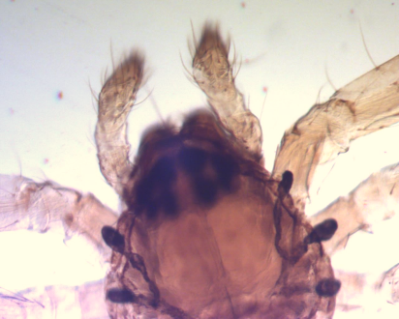
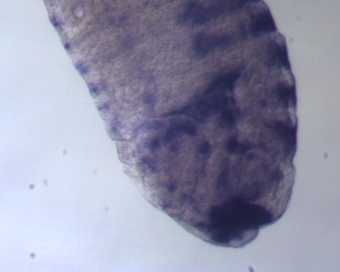
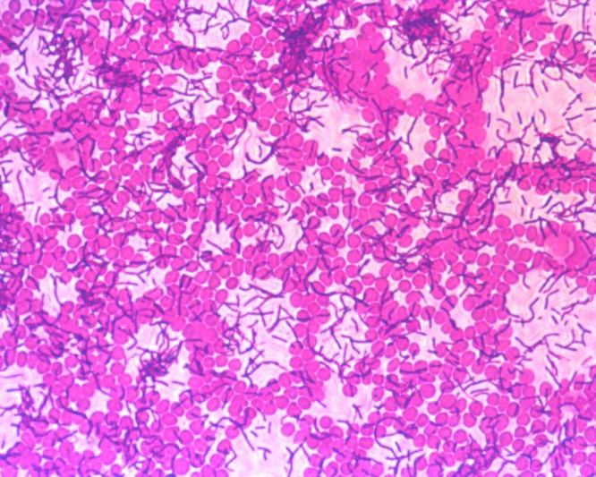
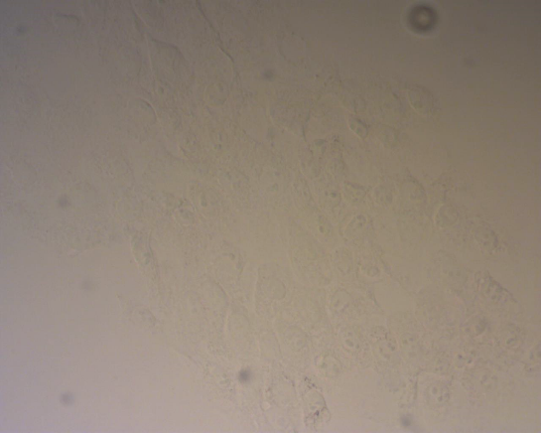
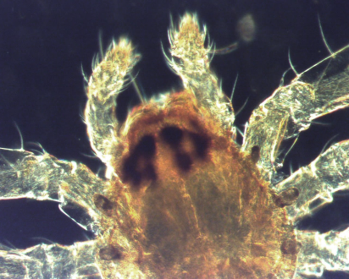
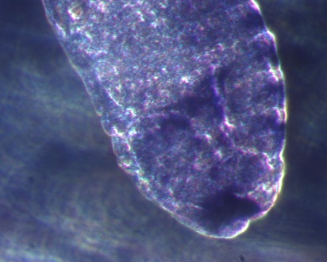
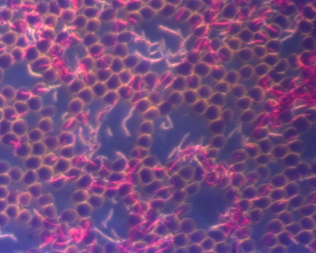
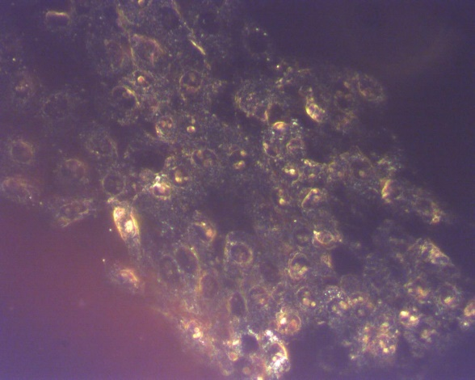
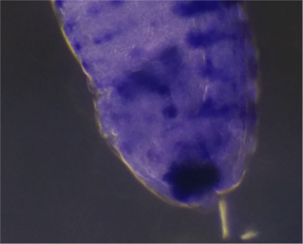
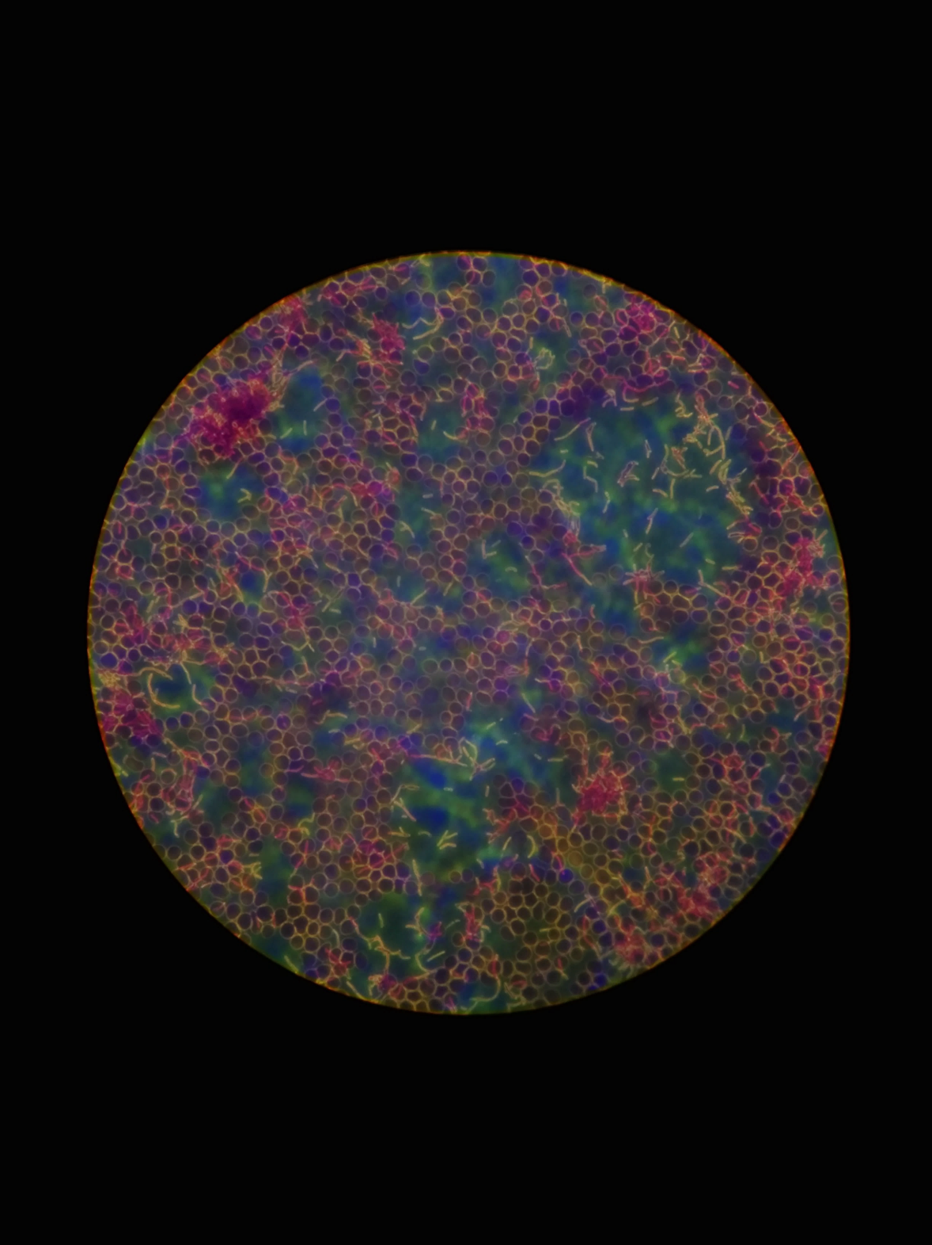
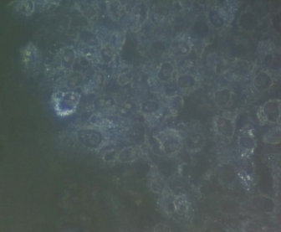
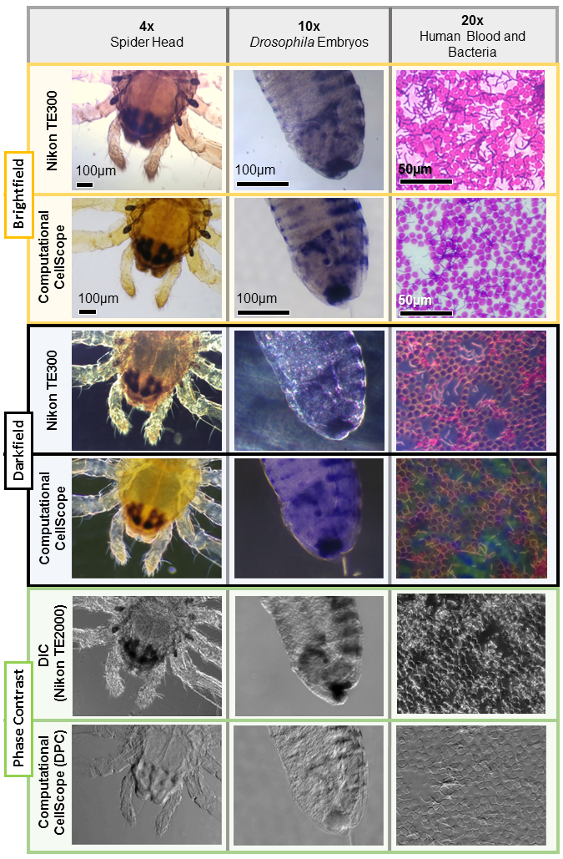
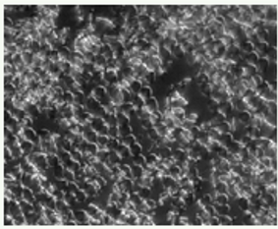
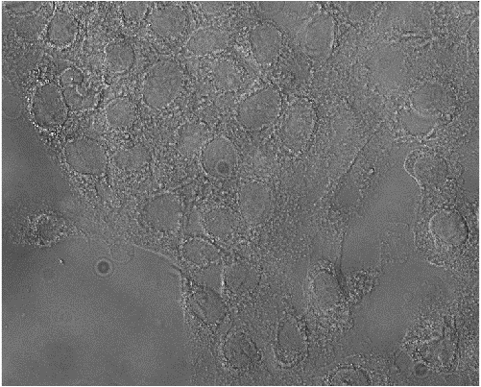
4x
Spider Head
10x
Drosophila Embryos
20x
Human Blood and Bacteria (Stained)
20x
MCF10A Cells
(Fixed, Unstained)
Nikon TE300
100µm
100µm
50µm
Brightfield
Computational
CellScope
Figure 4 – Comparison with Standard Microscope
-Computational CellScope acquires brightfield and darkfield images of similar quality to a standard upright microscope without the use of hardware inserts. Additionally, it enables phase imaging using Differential Phase Contrast, which contains similar information to standard phase contrast imaging, and can be inverted to obtain quantitative phase of the sample. The different color shades are caused by the relative hue of the halogen lamp vs. the LEDs.
100µm
100µm
50µm
Nikon TE300
Darkfield
Computational
CellScope
Nikon TE300
(DIC)
Computational
CellScope (DPC)
Phase Contrast
- 4.5
- 2.6
- 1.0
- 0.25
Comp. CellScope
(Quantitative Phase)
- 0
- 0
- 0
- 0
- -4.5
₋ -2.6
- -1.0
- -0.25
Quantitative Phase Delay (Radians)

Slide 5
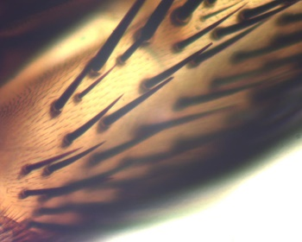
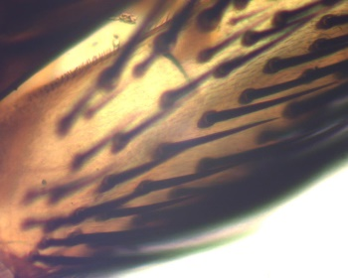
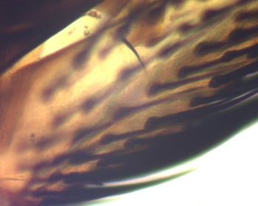
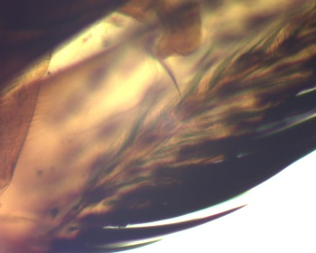
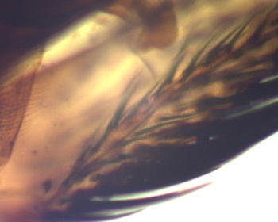
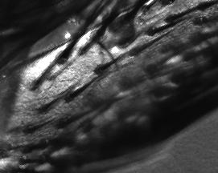
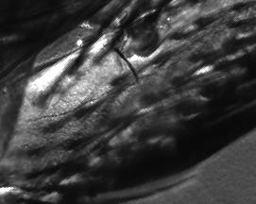
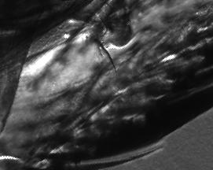

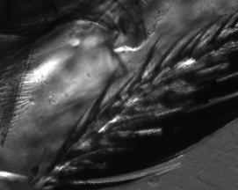
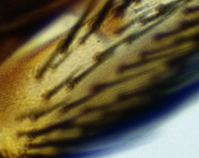

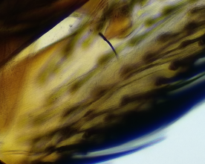
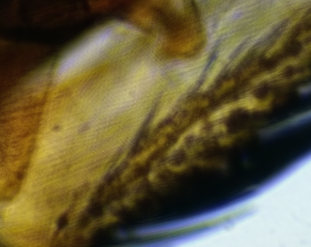
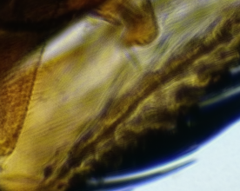
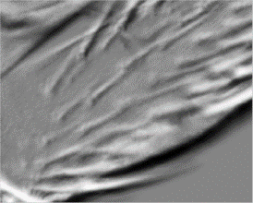
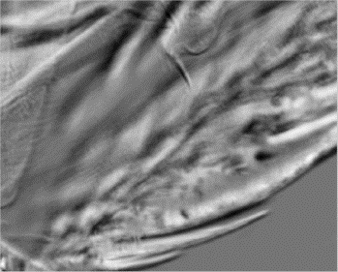








Brightfield
Physical Refocus (TE300)
100µm
Phase Contrast
(DIC)
100µm
Brightfield
100µm
Digital Refocus (Computational CellScope)
Phase contrast
Top / Bottom
100µm
Phase contrast Left / Right
100µm
Z = -100um
Z = -50um
Z = 0mm
Z = +50um
Z = +100um
Refocus Depth
Figure 5 – Digital Refocusing
Comparison of digital refocusing on Computational CellScope with physical refocusing on a Nikon TE300 inverted microscope. Digitally refocused Phase Contrast (DPC) images are also be computed for both vertical and horizontal contrast at different focus depths. Sample is a house fly wing (Amscope)

Slide 6
OLD/EXTRA

Slide 7












B
A
B
LED Pointing
Error (Dome)
Domed Array
Planar
Array
$$r$$
$$r+δ$$
$$r$$
Normalized intensity
$$Intensity ∝ \frac{1}{{(r+δ)}^{2}}$$
Sample
Angle of illumination (deg)
F
40X
C
D
E
$$δ=\frac{r}{\cos\left(θ\right)}−r$$
20X
$$δ≥0$$
Y angle (deg)
10X
LED
Positions
$$δ=0$$
X angle (deg)
Figure 2 – Domed LED Illuminator
Visual comparison of a planar array to a domed LED array. The intensity of a spherical wave degrades as a function of the inverse square of radius, thus illumination at the sample is heavily dependent on the distance between the LEDs and the sample. In the planar case (left), LED distance increases by a value $δ$ as a function of illumination angle, causing weaker illumination at higher angles. A domed LED array (right) eliminates this variation ($δ=0$ for all angles).
Normalized measured intensity falloff as a function of angle relative to the optical axis of a single LED. Red lines indicate the maximum pointing error of the LEDs due to mechanical tolerances, showing 1.2% illumination variation within this range. Dotted blue line indicates the intensity of LEDs arranged in a domed arrangement, illustrating the intensity falloff that is eliminated by the dome geometry.
C. Illumination pattern for a 0.25NA objective, used to acquire dark field image
D. Illumination pattern for a 0.25NA objective, used to synthesize differential phase contrast images
E. Illustration of arbitrary illumination patterning capabilities of the device
F. Plot illustrating relative objective and illumination NA for several common objective magnifications

Slide 8





A
B
Planar Array
Domed Array
$$r$$
$$r+δ$$
$$r$$
Sample
F
40X
G
Expected Pointing
Error
C
D
E
20X
Y angle (deg)
10X
Normalized intensity
LEDs
X angle (deg)
Angle of illumination (deg)
Figure 2 – Domed LED Illuminator
Visual comparison of a planar array to a domed LED array. The intensity of a spherical wave degrades as a function of the inverse square of radius, thus illumination at the sample is heavily dependent on the distance between the LEDs and the sample. In the planar case (left), LED distance increases by a value $δ$ as a function of illumination angle, causing weaker illumination at higher angles. A domed LED array (right) eliminates this variation ($δ=0$ for all angles).
Normalized mean pixel intensities as measured by the CCD for the planar and domed array. Intensity decreases as a function of angles in both cases due to vignetting at the objective at higher angles; however, the dome illumination is significantly stronger at high angles. Values were normalized to the maximum brightness in either case.
C. Illumination pattern for a 0.25NA objective, used to acquire dark field image
D. Illumination pattern for a 0.25NA objective, used to synthesize differential phase contrast images
E. Illustration of arbitrary illumination patterning capabilities of the device
F. Plot illustrating relative objective and illumination NA for several common objective magnifications
G. Normalized measured intensity falloff as a function of angle relative to the optical axis of a single LED used in this device. Red lines indicate the maximum pointing error of the LEDs due to mechanical tolerances, showing 1.2% illumination variation within this range. This contributes to very good flatness of illumination at the sample.

Slide 9





B
A
B
LED Pointing
Error (Dome)
Domed Array
Planar
Array
Normalized intensity
$$Intensity ∝ \frac{1}{{(r+δ)}^{2}}$$
Angle of illumination (deg)
F
40X
C
D
E
$$δ=\frac{r}{\cos\left(θ\right)}−r$$
20X
$$δ≥0$$
Y angle (deg)
10X
LED
Positions
$$δ=0$$
X angle (deg)
Figure 2 – Domed LED Illuminator
Visual comparison of a planar array to a domed LED array. The intensity of a spherical wave degrades as a function of the inverse square of radius, thus illumination at the sample is heavily dependent on the distance between the LEDs and the sample. In the planar case (left), LED distance increases by a value $δ$ as a function of illumination angle, causing weaker illumination at higher angles. A domed LED array (right) eliminates this variation ($δ=0$ for all angles).
Normalized measured intensity falloff as a function of angle relative to the optical axis of a single LED. Red lines indicate the maximum pointing error of the LEDs due to mechanical tolerances, showing 1.2% illumination variation within this range. Dotted blue line indicates the intensity of LEDs arranged in a domed arrangement, illustrating the intensity falloff that is eliminated by the dome geometry.
C. Illumination pattern for a 0.25NA objective, used to acquire dark field image
D. Illumination pattern for a 0.25NA objective, used to synthesize differential phase contrast images
E. Illustration of arbitrary illumination patterning capabilities of the device
F. Plot illustrating relative objective and illumination NA for several common objective magnifications

Slide 10

4x
Spider Head
10x
Drosophila Embryos
20x
Human Blood and Bacteria
Figure 4 – Comparison to Standard Contrast Methods
Computational CellScope acquires brightfield and darkfield images of similar quality to a standard upright microscope without the use of hardware inserts. Additionally, it enables phase imaging using Differential Phase Contrast, which is qualitatively similar to DIC imaging.
Nikon TE300
Brightfield
Computational
CellScope
Nikon TE300
Darkfield
Computational
CellScope
DIC
Need DIC comparison images
Phase Contrast
Computational
CellScope

